Slide 1
FINAL PROJECT
Learn to make CV and Sales Dashboard Sheet on Excel

Slide 2
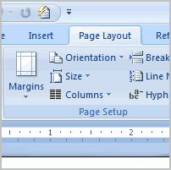
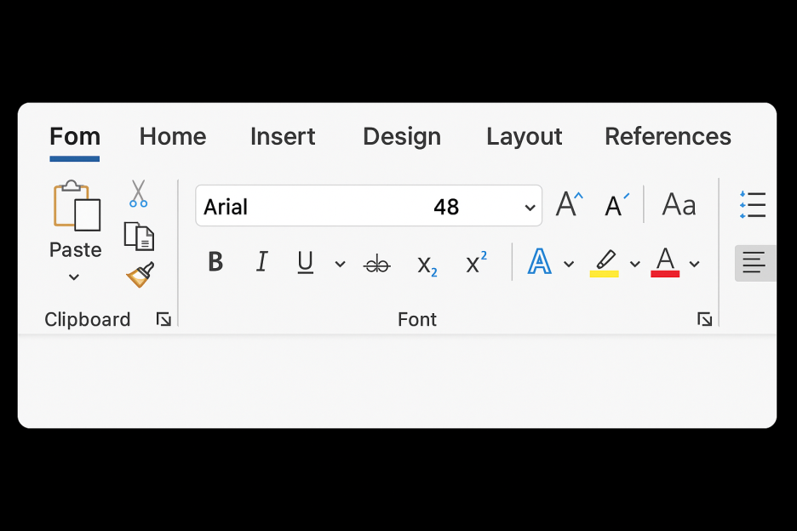
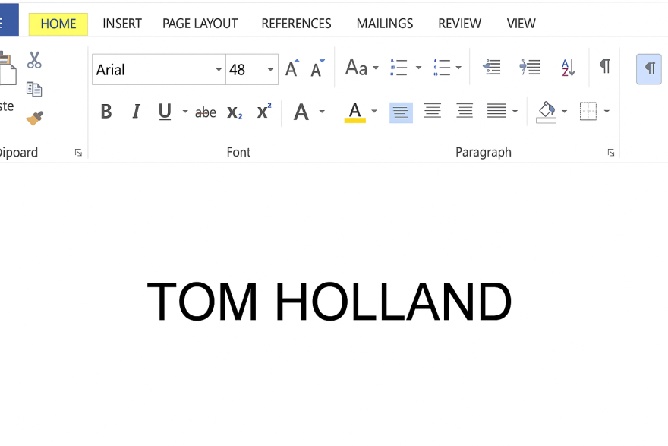
1:Open ms-word and directly go to page layout option and change page size to A4 and Margins(narrow). 2:Font:ARIAL, size:48 for main heading,14 for subheading and 12 for simple text.Give your name a main heading. And under your name write your gmail, native city/country, number and linkedin username if you have.

Slide 3
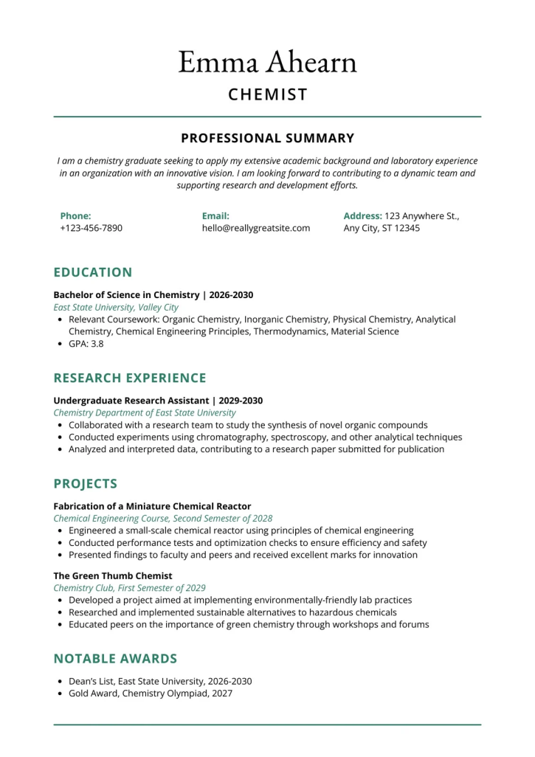
4:Write about your professional summary then education,work experience,skills and certificates. 5:Make sure to use borders (line border) after every heading you make.
6:Make bullets points for better understanding.
7:Just write year and month when you done your education and also write year/date if you have work experience before.
=>CV DONE<=

Slide 4
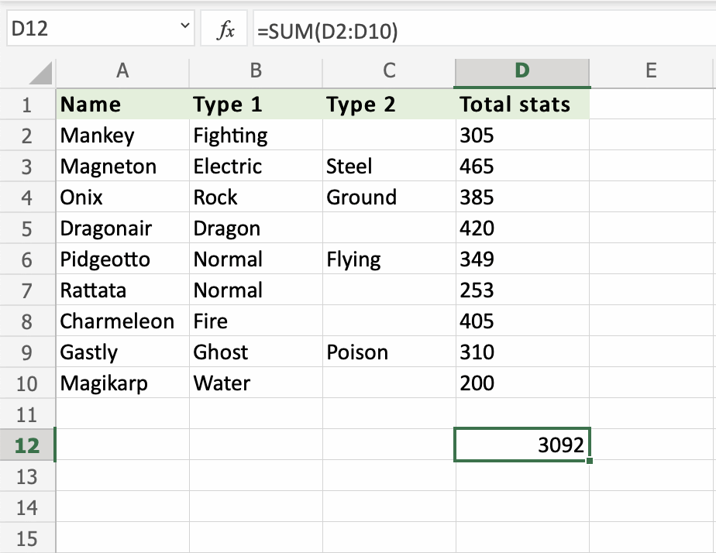
=>SALES DASHBOARD SHEET<=
1:Gather sales data (e.g., Date, Product, Region, Salesperson, Sales Amount).
2:Fill every columns by entering correct data make sure you enter correct unit sold and unit prices.
3:Use formula of SUM to get Total sales (Example as given through picture).
4:Colour headings if you want.

Slide 5
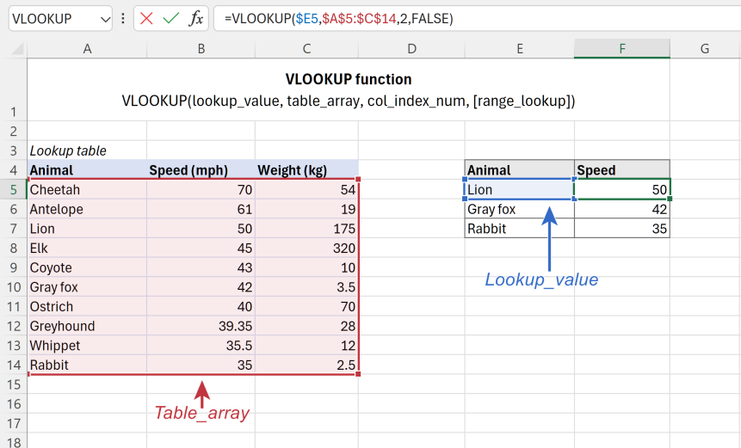
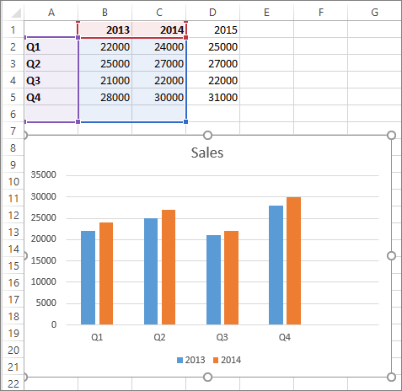
:USING MORE FORMULAS:
5:Apply any type of graphs for better understanding.
6:Apply VLOOKUP formula to find someone’s record.
7:Font:Cambria(optoinal)

Slide 6
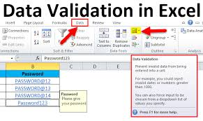
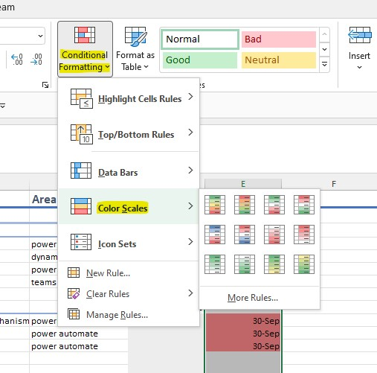
Data Validation and Conditional Formatting:
8:Apply data validation for giving users a INSTRUCTIONS and if they dont follow the instructions give them error or restrict them by giving WARNING note.
9:Apply conditional formatting on any amounts option.

Slide 7
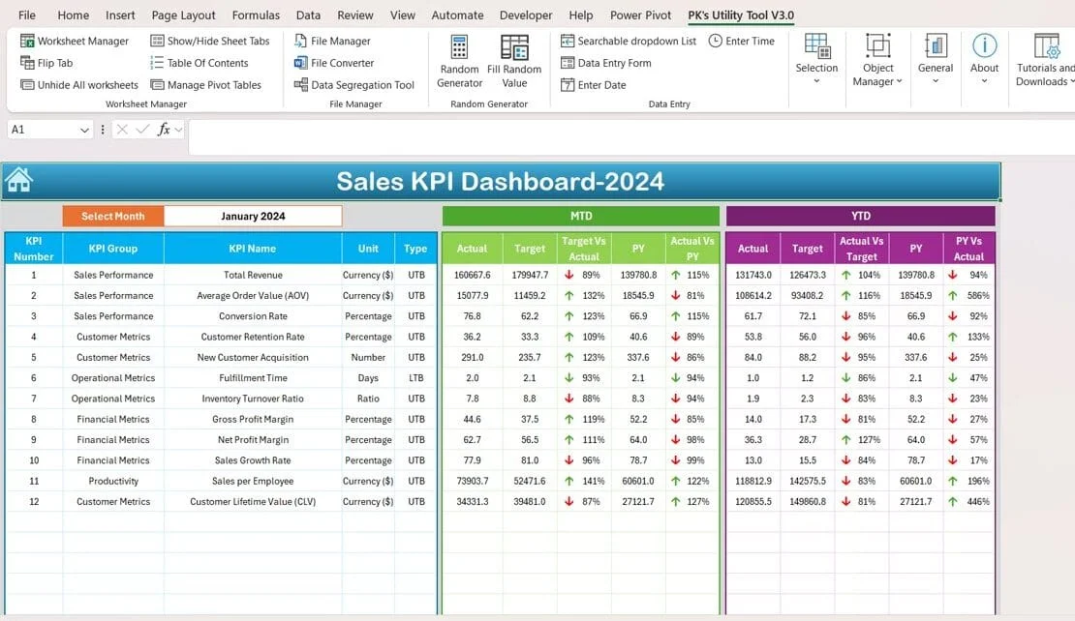
=>THIS IS HOW YOUR SALES DASHBOARD SHEET ON EXCEL LOOKS LIKE<=

Slide 8




=>FINAL PROJECT COMPLETED<=
Explore the World of Computer more.
Computer Technology is so built into our lives that it’s the part of the surround every artist.

